Slide 1

Major Project – MCA491P
IoT Based Smart Irrigation in Arecanut Farms
1RV23MC039
HARI KETAN T
Under the Guidance
Of
Dr. Renuka Prasad B
Associate Professor
Department of MCA

Slide 2
Agenda
Tools and Technologies Used
Hardware and Software Requirements
Functional Requirements- Module specification
Non-functional Requirements
Design Constraints
System design- Architecture design
Detailed Design- Class Diagram, Use Case diagram, sequence diagram, activity diagram and DFD (level-0 to level-2)
References

Slide 3
Project based Learning
Sl No | Particulars / Details | Details of Implementation
1 | Course on “ReactJS” | It helps us to design the frontend of the web interface
2 | Course on “NodeJS” | It helps to build the backend of the web application
3 | Course on ”PostgreSQL” | It helps to create a Schema and Database

Slide 4
Design Methodology
Hardware Requirements
Sl No | Components | Purpose
1 | ESP32 | Collects data from sensors; sends via MQTT
2 | Soil Moisture Sensor (Capacitive V2.0) | Monitors real-time moisture near root zone
3 | Water Flow Sensor (e.g., YF-S201) | Measures volume of water supplied
4 | Motorized Valve | Controls irrigation based on command
5 | Wi-Fi Relay Module | Activates valve based on control logic
6 | Raspberry Pi (Gateway) | Receives MQTT data; handles control logic
Software Requirements
Sl No | Components | Purpose
1 | Next.js (Frontend) | Web dashboard for farmers
2 | MQTT Broker (Mosquitto) | Lightweight messaging protocol
3 | PostgreSQL | Database to store sensor readings & logic
4 | Node.js + Express | API backend for sensor data
5 | MicroPython / Arduino IDE | Programming ESP32 sensor logic

Slide 5
Design Methodology
ESP32 + MQTT provides lightweight, scalable communication between sensors and backend.
Raspberry Pi can act as an edge computing node, reducing latency.
PostgreSQL supports complex queries, joins, and accurate timestamp-based logging.
Next.js helps create a responsive and interactive dashboard for farmers.
Nodejs acts as a server and provides dynamic data continuously to the interface
Python scripts make it easy to implement logic and modify rules without full re-deployment.
Rule-Based Scheduling Algorithm
The goal of this algorithm is to automatically decide whether to start or skip irrigation based on predefined rules derived from domain knowledge such as soil type, crop age, and monthly water needs.
1. Collect Inputs
2. Calculate Plant Age
3. Determine Plant Age Stage
4. Fetch Required Moisture Threshold
5. Decide Based on Mode
6. Output Action

Slide 6
Functional Requirements Specification
Module Name: Soil Moisture Monitoring
Purpose: To continuously measure soil moisture and determine irrigation need.
Input: Analog signal from capacitive soil moisture sensor.
Function: Converts sensor data to digital, compares against threshold, sends to backend.
Output: Moisture percentage, timestamp, and section ID pushed via MQTT.
Module Name: Water Requirement Calculation
Purpose: To fetch the ideal water requirement for a section based on crop age, month, and soil.
Input: Soil type, current month, plant age (from planting date).
Function: Fetches required value from Water_Requirement table.
Output: Ideal liters/day/palm value used by decision logic.
Module Name: Irrigation Control (Auto/Manual)
Purpose: To control the valve state based on logic or manual command.
Input: Mode (AUTO/MANUAL), moisture value, required water, user input.
Function: If AUTO: checks if moisture < threshold; triggers relay via Raspberry Pi. If MANUAL: user control overrides logic.
Output: Valve ON/OFF signal, recorded in control log.
Module Name: Water Flow Monitoring
Purpose: To measure actual water delivered during irrigation.
Input: Digital pulses from flow sensor (YF-S201).
Function: Converts pulses to L/min, multiplies by duration to get volume.
Output: Water volume in liters; logs for accuracy tracking.

Slide 7
Non-Functional Requirements Specification
Sl No | Components | Purpose
1 | Performance | The system shall respond to sensor updates and take control actions within 10 seconds.
2 | Scalability | The system shall support up to 10 farm sections and 50 sensors without performance degradation.
3 | Accuracy | Moisture readings should have an accuracy of ±5%, and flow readings ±10%.
4 | Reliability | System actions (irrigation ON/OFF) must execute correctly 100% of the time based on logic.
5 | Data Logging | All sensor and control actions shall be logged and retrievable for a minimum of 30 days.

Slide 8
Design Constrains
Sl No | Constraint Type | Description
1 | Technical | Soil moisture sensors only monitor local zones, not entire field uniformity. The system supports single-zone irrigation in current prototype.
2 | Time | Project must be completed within the academic semester duration (4 months). Integration and testing across hardware and software must fit into limited lab sessions.
3 | Budget | Limited to affordable components; avoids high-end sensors or commercial-grade controllers. Optional add-ons like weather forecasting, GSM failover, or solar power were skipped.
4 | Resources | Development team consists of students; external consulting or large deployments are out of scope. Prototype tested on a small-scale model (1–2 sections) only.
5 | Deployment | Initial deployment is on-premises, not hosted on cloud (to minimize costs). Farmers need basic digital literacy to interact with the system.

Slide 9
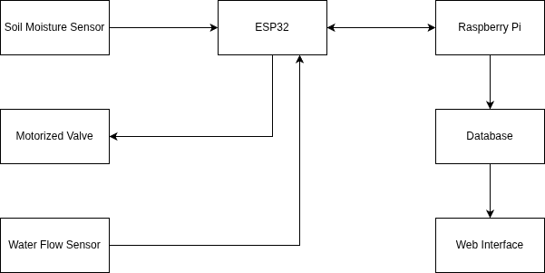
System Design
Block Diagram

Slide 10
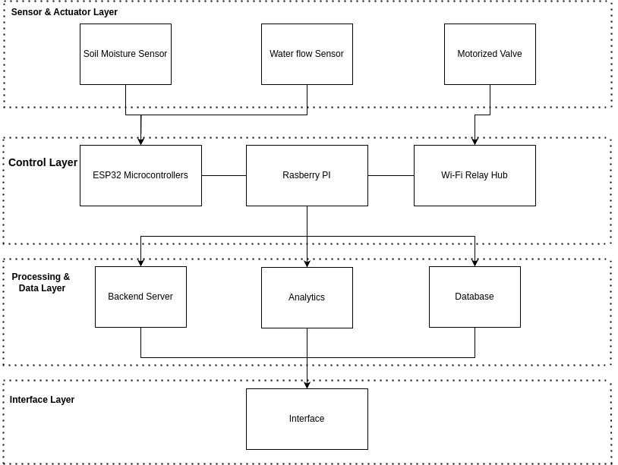
System Design
Architecture Diagram

Slide 11
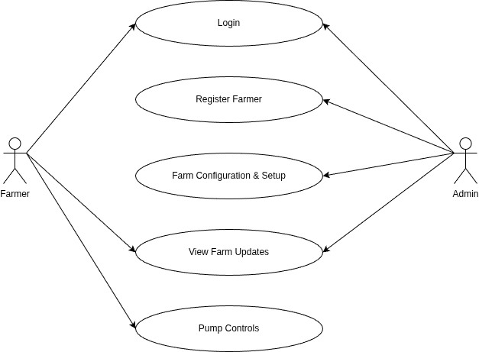
Detailed Design
Use Case Diagram

Slide 12
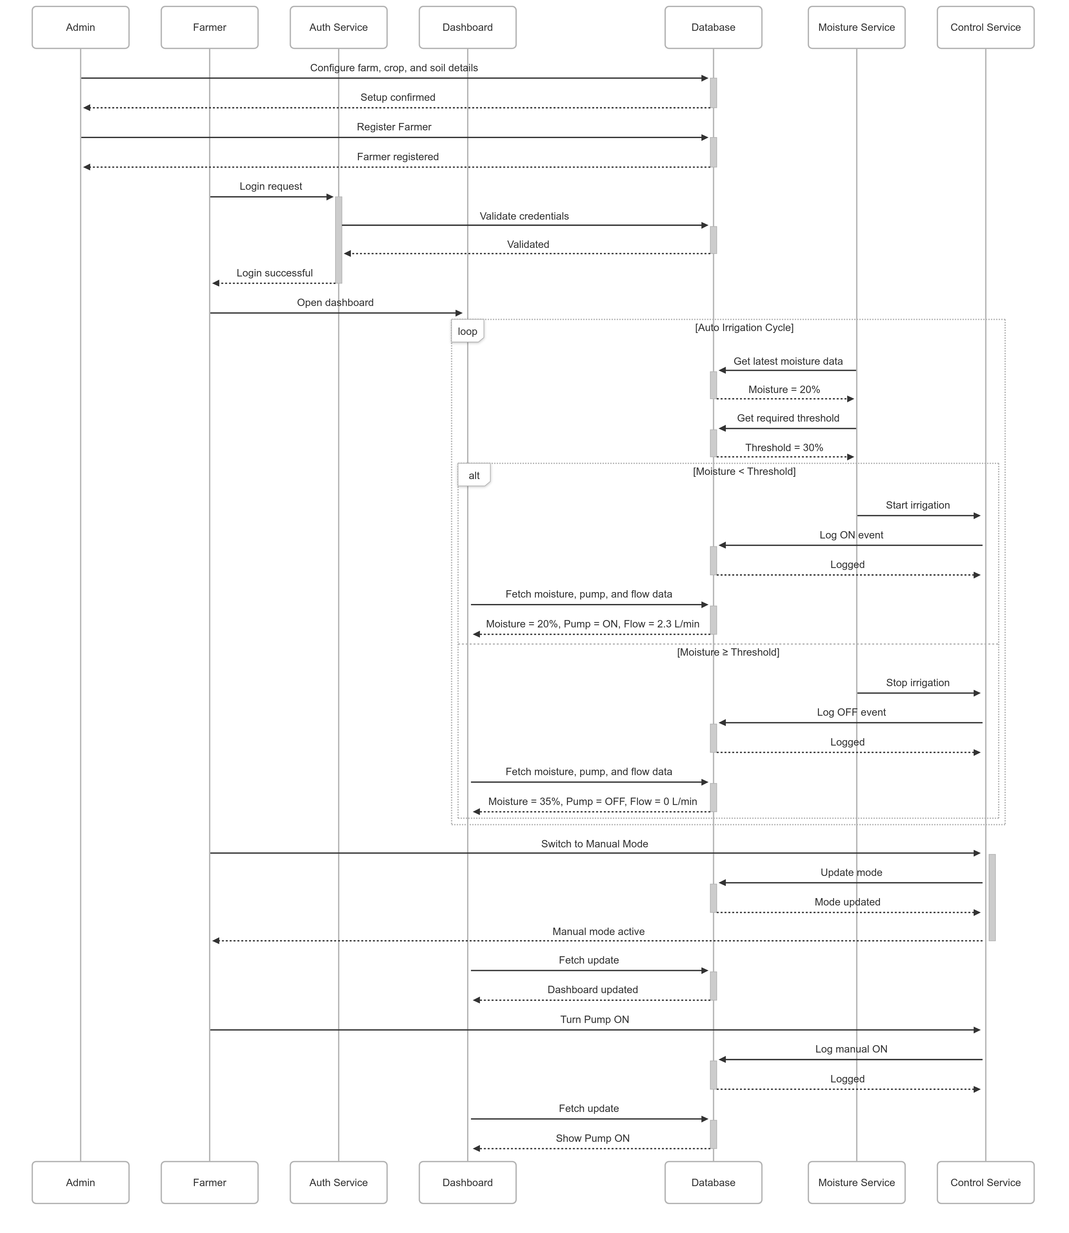
Sequence Diagram

Slide 13
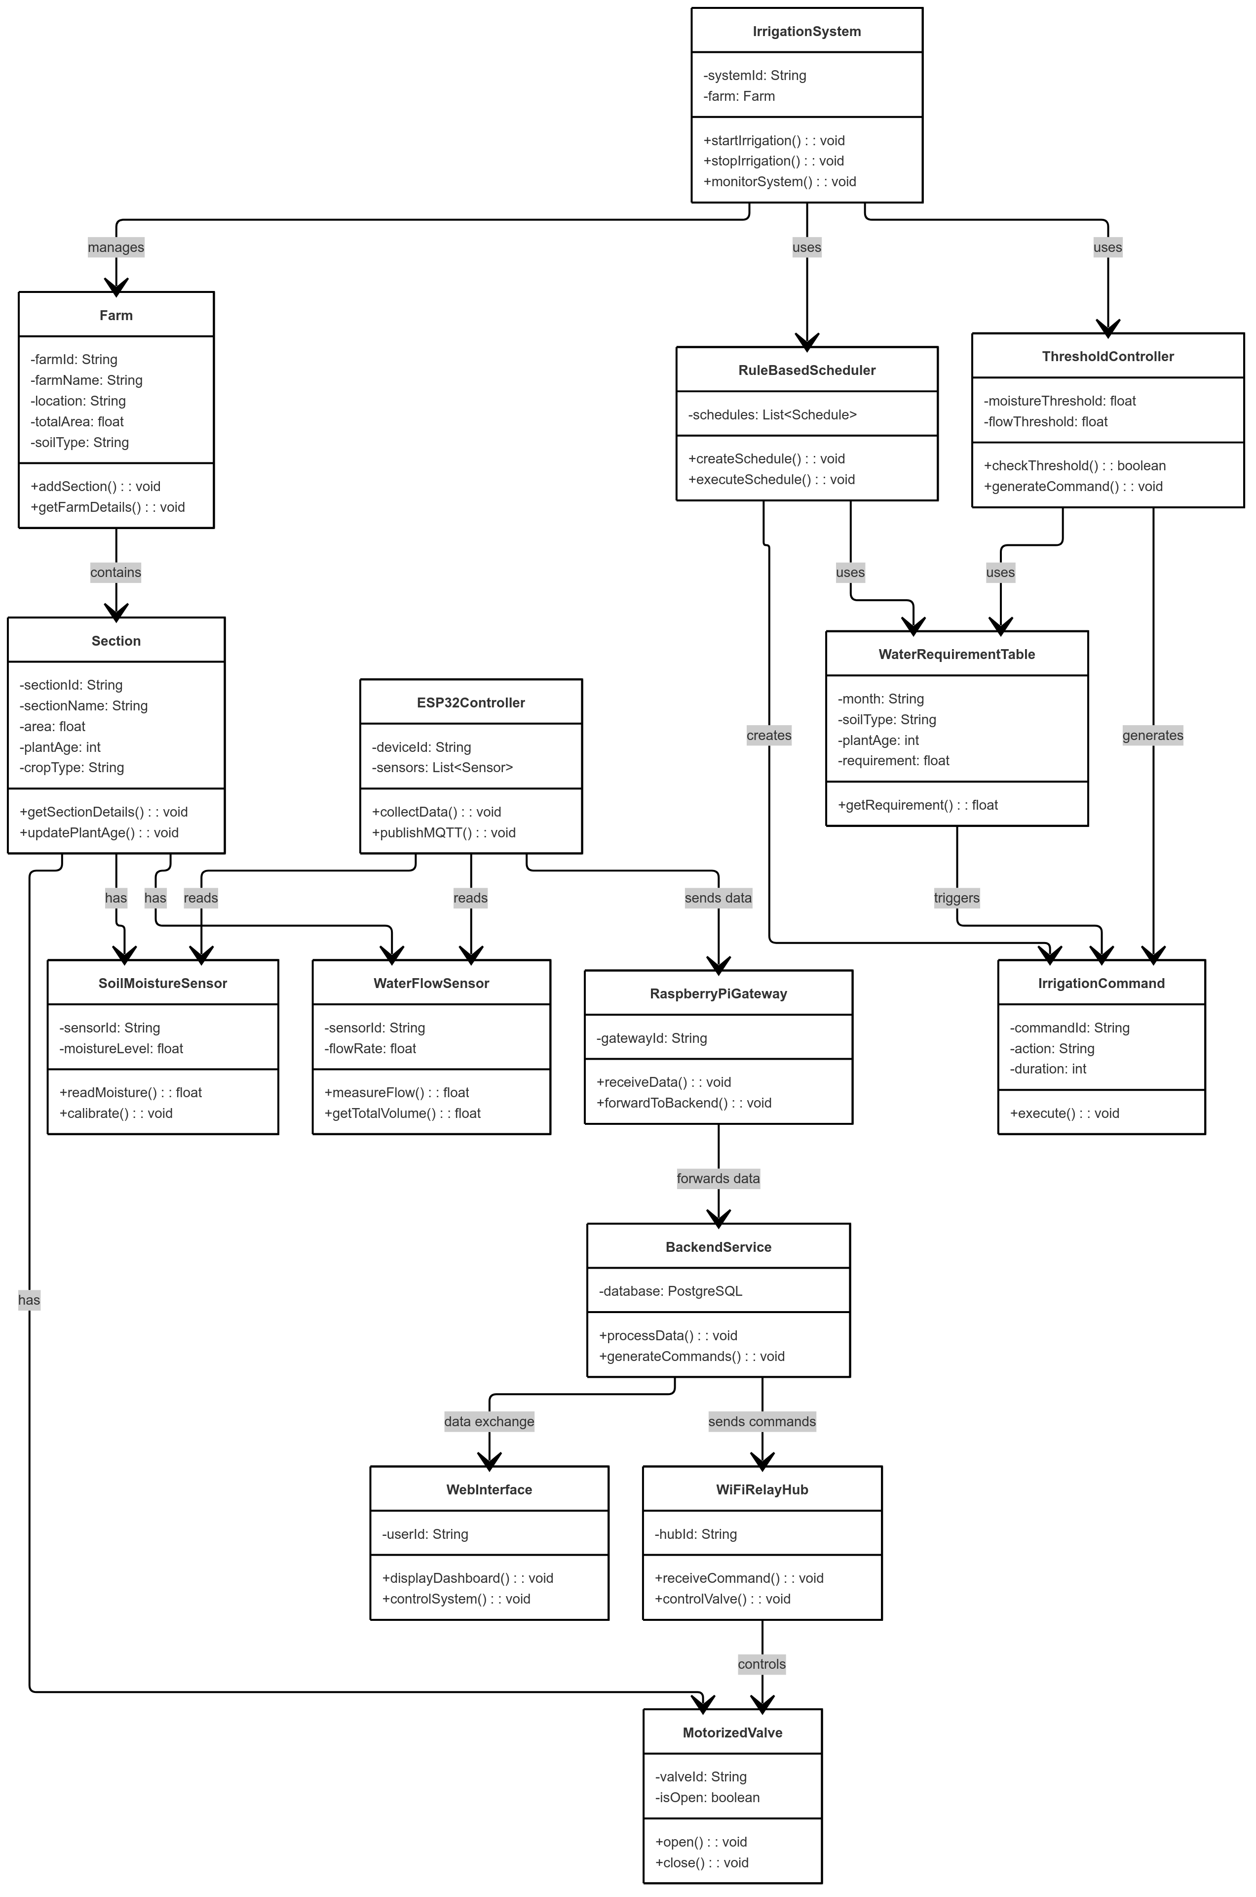
Class Diagram

Slide 14
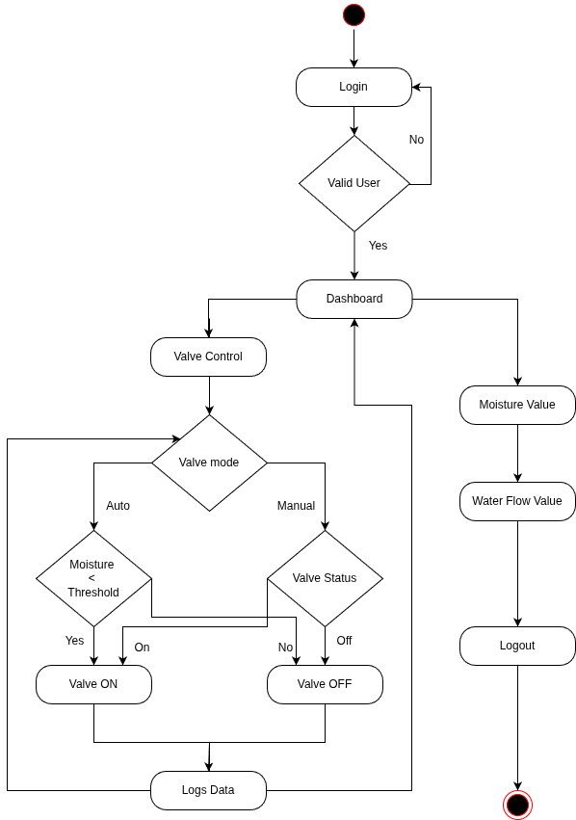
Detailed Design
Activity Diagram

Slide 15
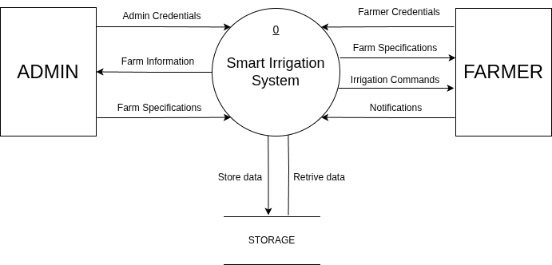
Detailed Design
Level 0 DFD

Slide 16
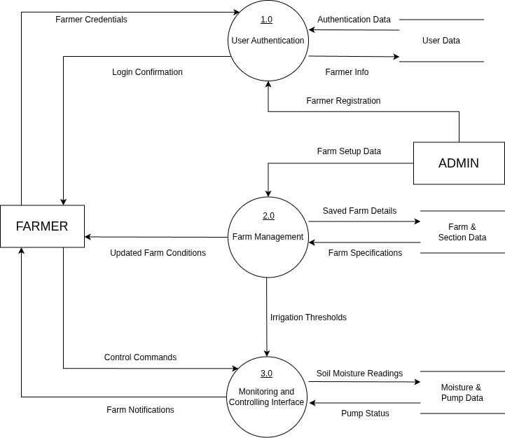
Detailed Design
Level 1 DFD

Slide 17
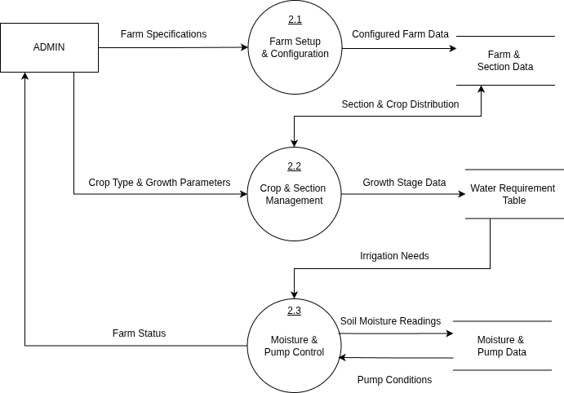
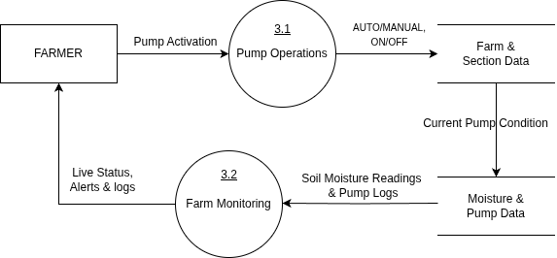
Detailed Design
Level 2 DFD

Slide 18
References
[1] SharathKumar KR, Mohan K, and Nirisha, “Arecanut Crop Disease Prediction using IoT and Machine Learning”, Journal of Science; Technology , vol. 5, no. 3, pp. 160–165, May 2020.
[2] Jyothi R, Rachana S, Ranjitha R, Krishna Prasad R, “Smart Irrigation System Based on Iot”, IJAST, vol. 29, no. 3, pp. 5730 - 5737, Mar. 2020.
[3] A. J. Rao, C. Bekal, Y. R. Manoj, R. Rakshitha, N. Poornima, “Automatic Detection of Crop Diseases and Smart Irrigation Using IoT and Image Processing,” in Advances in Communication and Computational Technology, Springer, pp. 343–353, 2021.
[4] S. Ramya, A. M. Swetha, M. Doraipandian, “IoT Framework for Smart Irrigation Using Machine Learning Technique,” Journal of Computer Science, vol. 16, no. 3, pp. 355–363, Mar. 2020.
[5] Raja Muthuramalingam, Reshnuvi Rathnam Velu, Harshini Baskar, Merun Hrithik Vellan Saminathan, “An IoT-Based Smart Irrigation System,” Engineering Proceedings, vol. 66, no. 1, pp. 13, July 2024.
[6] I. Ravi, G. Prabhu, P. S. Shelake, R. Selvarajan, and V. B. Patel, “IoT enabled soil moisture sensor based irrigation in banana”, Ind. Horticulture, vol. 69, no. 6, pp. 17–21, Jan. 2025
[7] Hema Losini Jayashanker, Nurmiza Othman, “IoT Based Irrigation and Fertigation System for Smart Smallholder Farming Application,” Emerging Advances in Integrated Technology, vol. 5, no. 1, pp. 16–25, July 2024.
[8] Eddala Chandu, M. K. Shukla, “IoT-Based Smart Irrigation System for Mango Orchard,” in Artificial Intelligence and Machine Learning in Satellite Data Processing and Services, Springer, pp. 61–69, Jan. 2023.
[9] D. Thakur, Y. Kumar, S. Vijendra, “Smart Irrigation and Intrusions Detection in Agricultural Fields Using IoT,” Procedia Computer Science, vol. 167, pp. 154–162, 2020.
[10] Manish Vasant Gurao and U. B. Vaidya, “IOT based Smart Irrigation System,” International Journal of Engineering Research & Technology (IJERT), vol. 11, no. 11, Nov. 2022.

